Slide 1
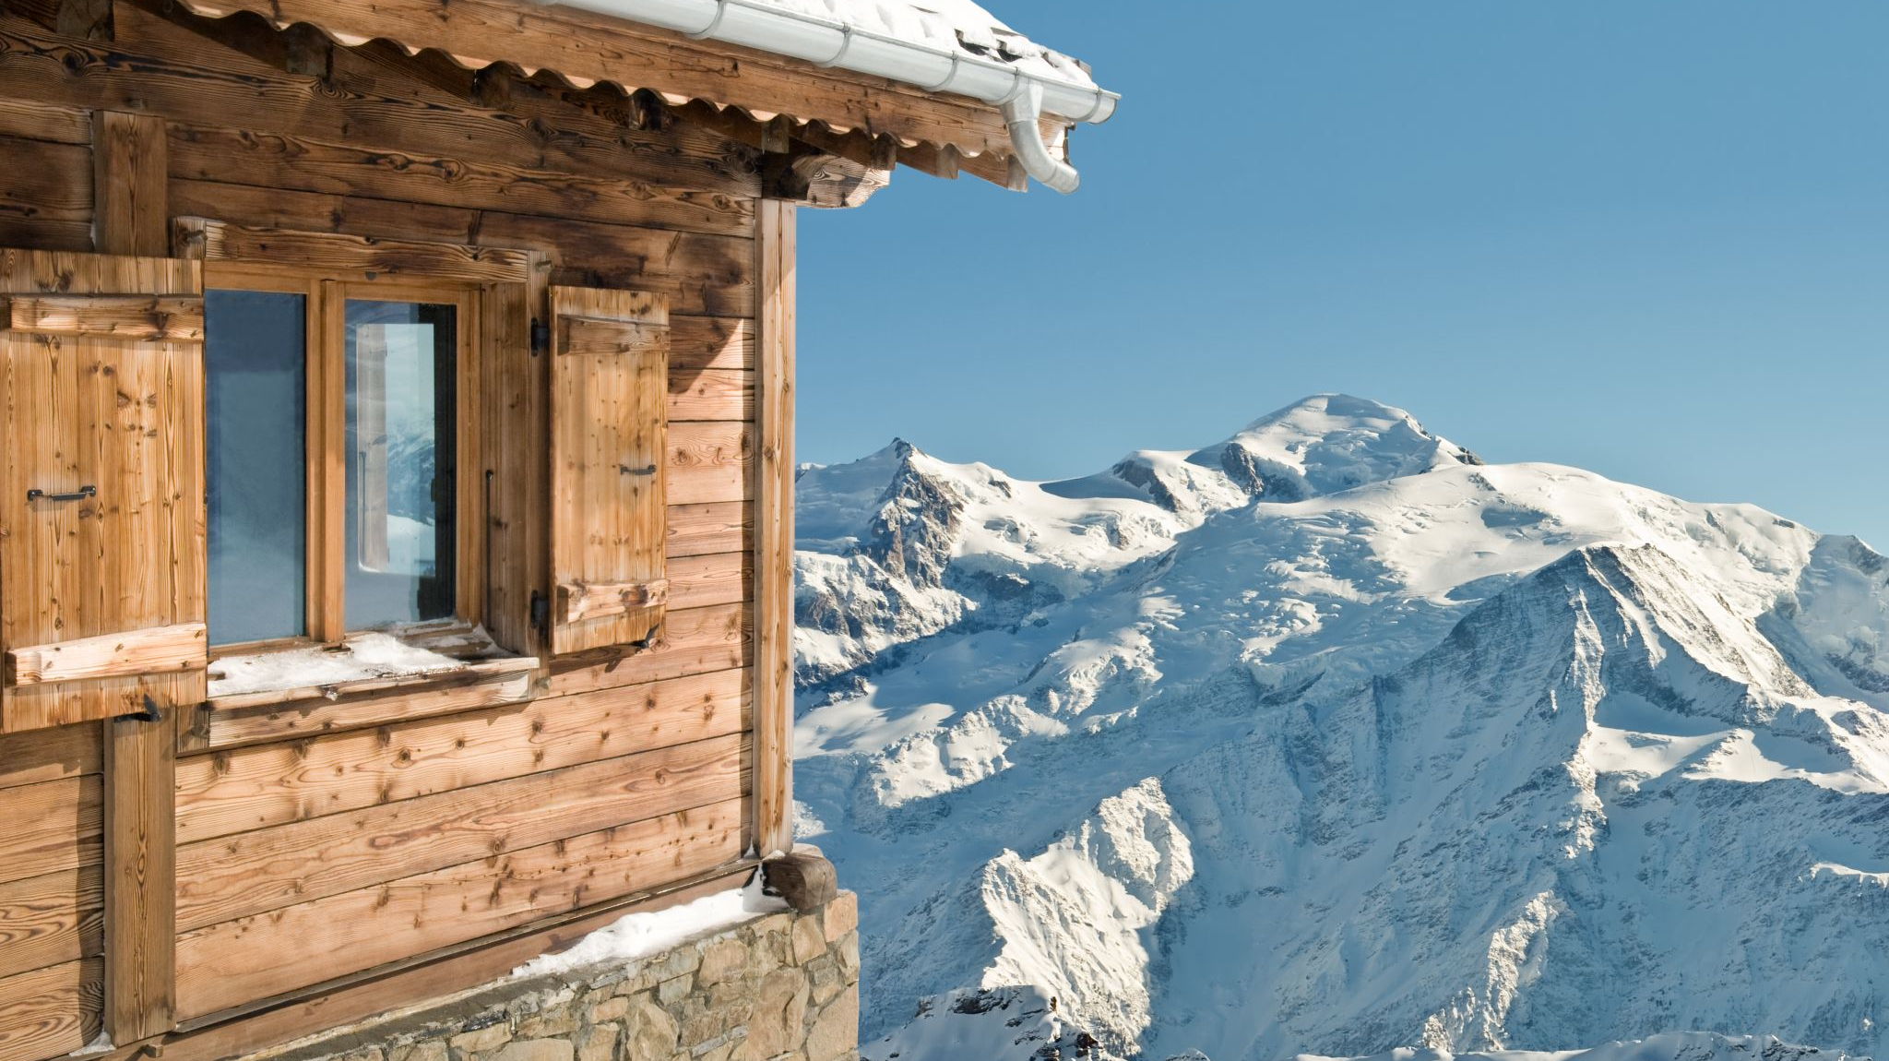
Big Mountain Resort Pricing Strategy
Presentation By– Irtaza Aslam

Slide 2

Table of Content
Problem identification
Recommendation and key findings
Modeling results and analysis
Summary and conclusion

Slide 3
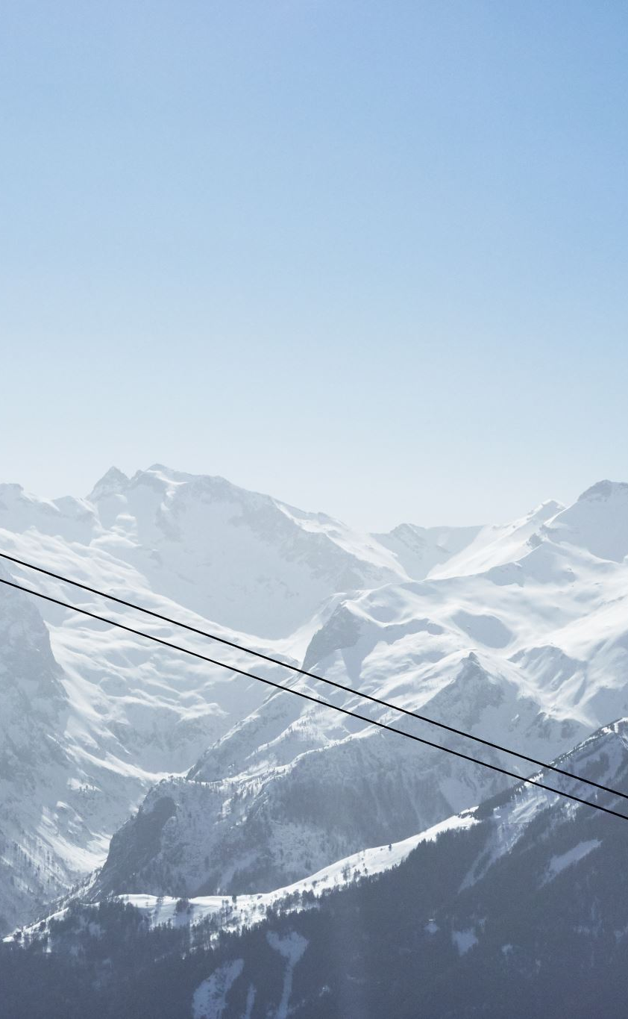
Problem Statement
How Big Mountain resort could alter its pricing strategy to lower the operation cost to recoup the increased operational cost of $1.54MM for installing new chair list this season, while keeping the profit margins at 9.2% and give an insight on annual revenue for the season over the next year by
Optimizing the ticket prices by comparing their facilities with other resorts in their market segment using data-driven strategies
Analyzing 4 different scenarios provided by the Big Mountain team.
Suggesting the best strategy business executives can use to predict prices and plan the revenue.

Slide 4
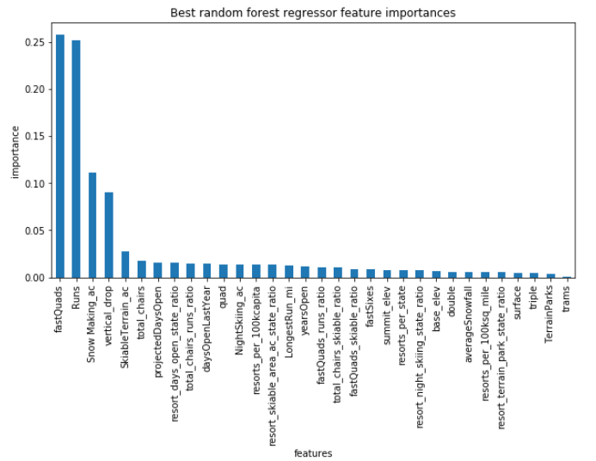
Recommendation and key findings
The top 4 Features which has the most impact on the Ticket Pricing are:
Fast Quads
Runs
Vertical Drops
Snow Making area
These features are identified using random forest model and these features should be focused while planning any future marketing strategy to optimize the revenue:

Slide 5
Modeling results and analysis
Industry Standard Data Science Model (DSM) was Utilized to Develop the Ticket Pricing Model
The Random Forest model was chosen from different modeling strategies for the Big Mountain resort for their Pricing strategies.
Further Analysis shows that the Big Mountain is providing enough features to attract tourists.
Recommendations for the given scenarios

Slide 6
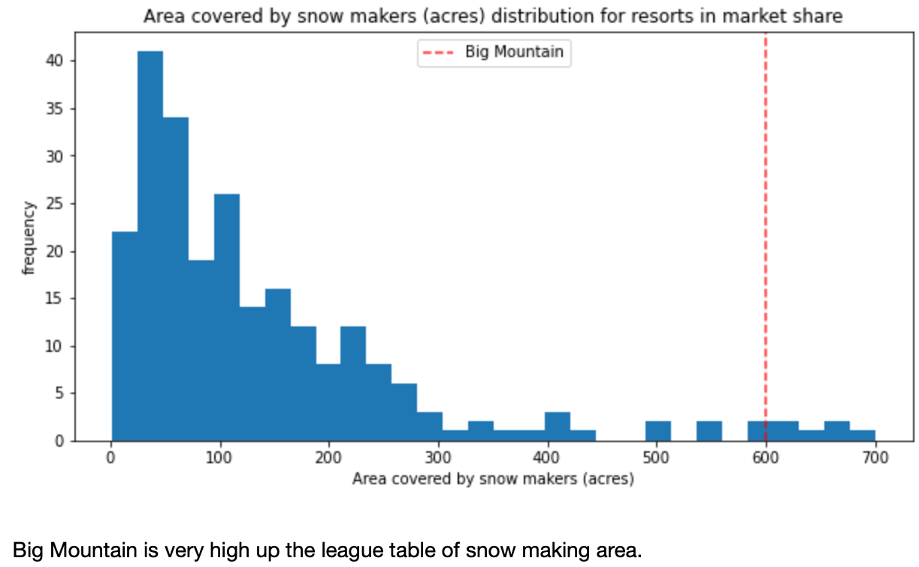
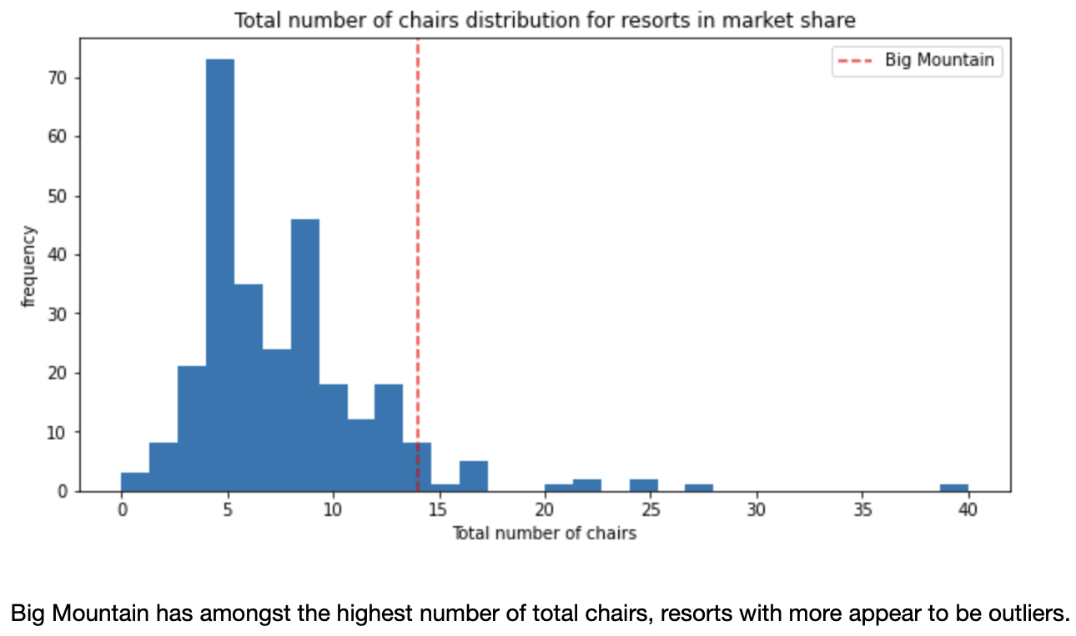
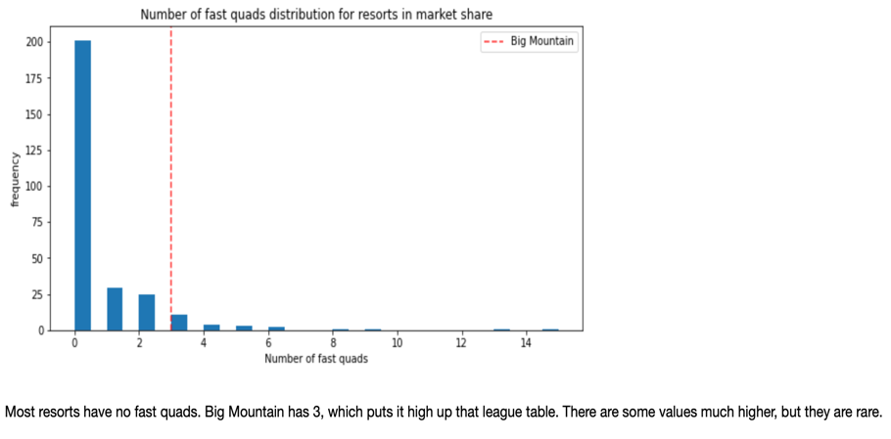
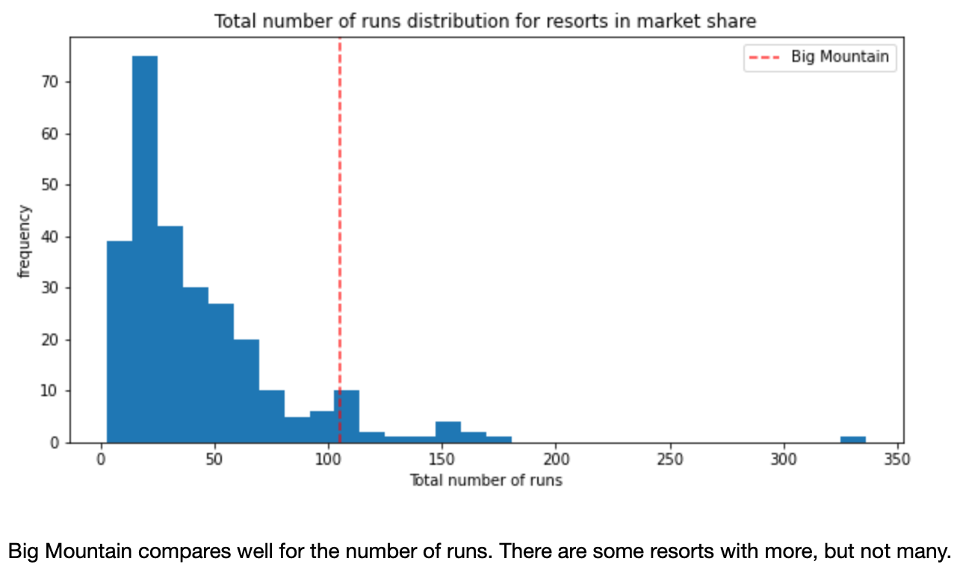
Further Analysis shows that the Big Mountain is providing enough features to attract tourists.

Slide 7
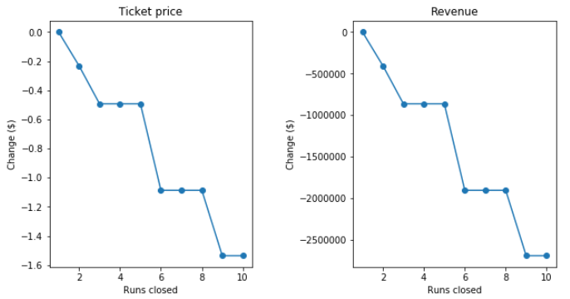
Analysis of the given scenarios
Scenario 1: Permanently close down up to 10 of the least used runs in order to reduce the operating cost
“Compare Revenue Reduction with the Operating Cost Savings to Assess if 5 runs can be closed”

Slide 8
Scenario 2: Increase the vertical drop by adding a run to a point 150 feet lower down but requiring the installation of an additional chair lift to bring skiers back up, without additional snow making coverage
Based on the model, Big Mountain can increase the ticket prices by $1.99
Scenario 3: Increase the vertical drop by adding a run to a point 150 feet lower down but requiring the installation of an additional chair lift to bring skiers back up, with additional snow making coverage of 2 acres
No additional revenue, hence, not recommended to explore any further
Scenario 4: Increase the longest run by 0.2 miles and guaranteeing its snow coverage by adding 4 acres of snow making capability
This can help increase the ticket price by $0.20. Even smaller increase !

Slide 9
Summary and conclusion
In conclusion, the modeling results provide valuable insights for Big Mountain's business leadership to optimize ticket pricing, consider the additional operating cost of the new chair lift, and explore potential scenarios for future improvements. With data-driven recommendations and careful testing, the business can make informed decisions to enhance its competitiveness and guest satisfaction while maintaining financial viability.

